Slide 1


Team Wizards
The All-in-one solution for College Students
Yash, Devansh, Deepak & Saikat

Slide 2
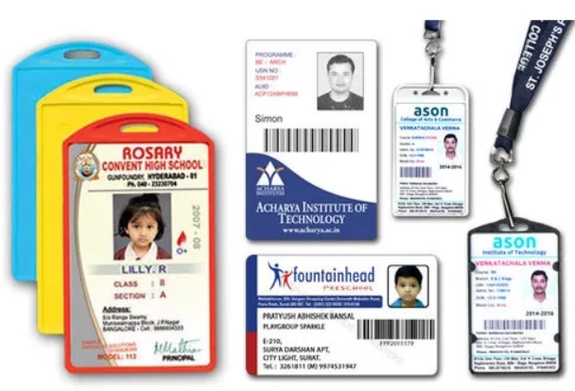
Too many cards to keep?
Why do we need to carry an ID Card, a Library Card, a Bus Card, a hostel card, or maybe a debit card in a university campus all the time?🤔🙄
For multiple operations… Right?
But what if we tell you that there’s no need to carry individual cards all the time and just one card can solve the purpose.🙂

Slide 3
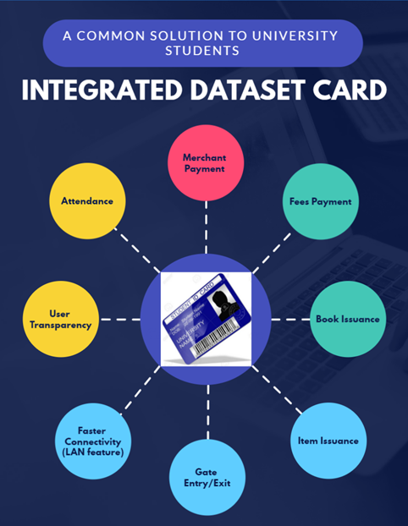
Many Operations,
One Solution
The 1D Card!

Slide 4
How does it work?
1D Card is an integrated dataset card that uses a common UIMS(University Information Management System) and derives all its’ data from it.
This card is based on tap and swap payment technique as well as a QR code is provided on this card carrying UID of every student/teacher that can be scanned by the concerned department for attendance, issuance, entry/exit etc.
The payment card uses Digital Wallet protocol and works only under LAN in university premises/ university ID.

Slide 5
How does it make the difference?
You don’t need to use separate cards when you have our multipurpose ID card. Every need of a university student has been assembled in our ID card. Just swap, scan and pay. It’ll save students’ as well as staffs’ time, reduce paper-work significantly, and help to unite all the essentials into an ecosystem; An University made ecosystem- Students, staff and merchants.

Slide 6
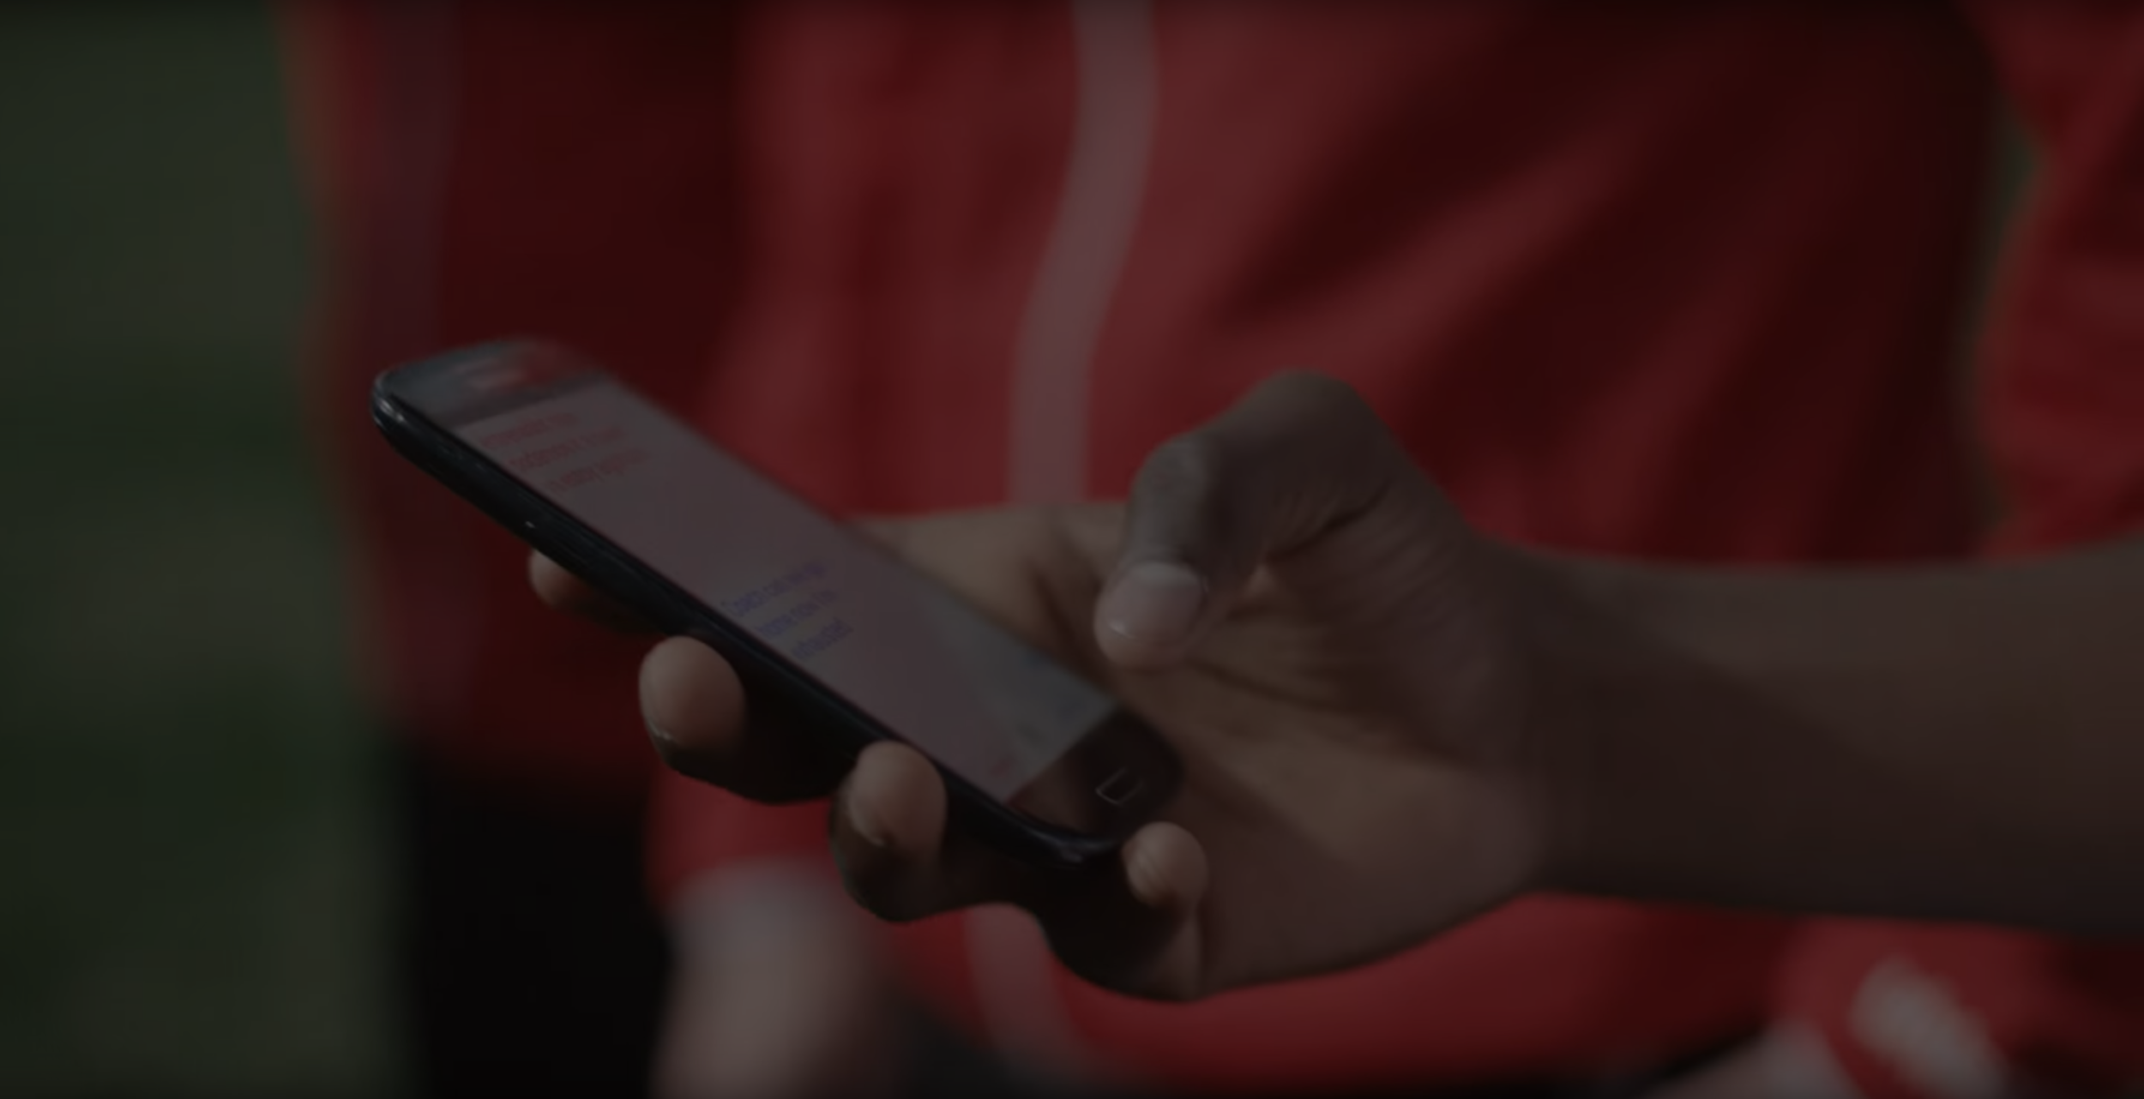
A resource unified is a barrier removed.
Rather than bearing a library card to issue a book, an identity card for attendance and your phone/wallet all the time to pay merchants inside university premises. Also several institutions are located in remote areas so the network coverage is terrible-which significantly reduces success rate in online transactions. This tap and pay feature using near field communication using LAN server will increase reliability and will reduce time variable significantly and save a lot of time.

Slide 7
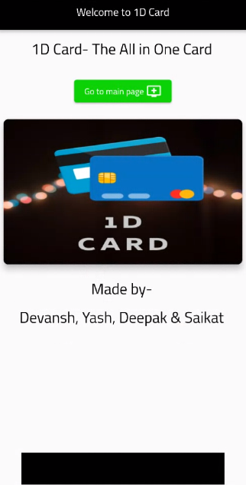
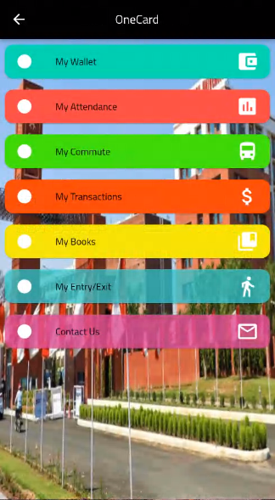
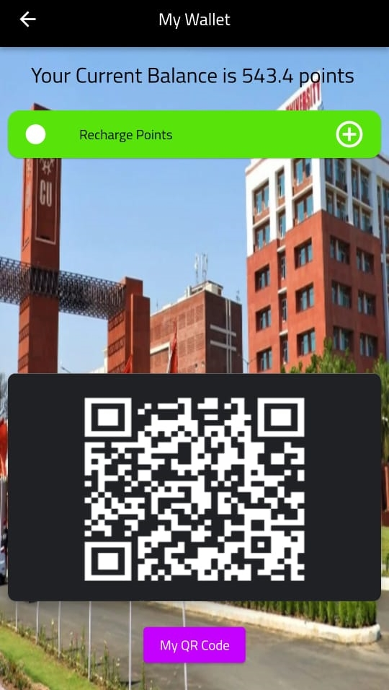
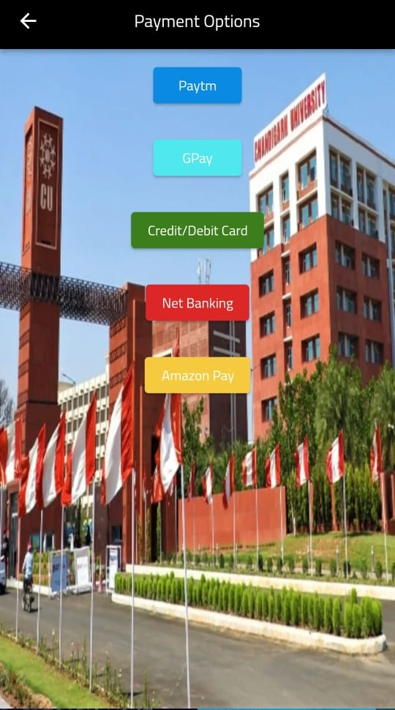
Some Screenshots of our UI

Slide 8
THANK YOU

